Slide 1


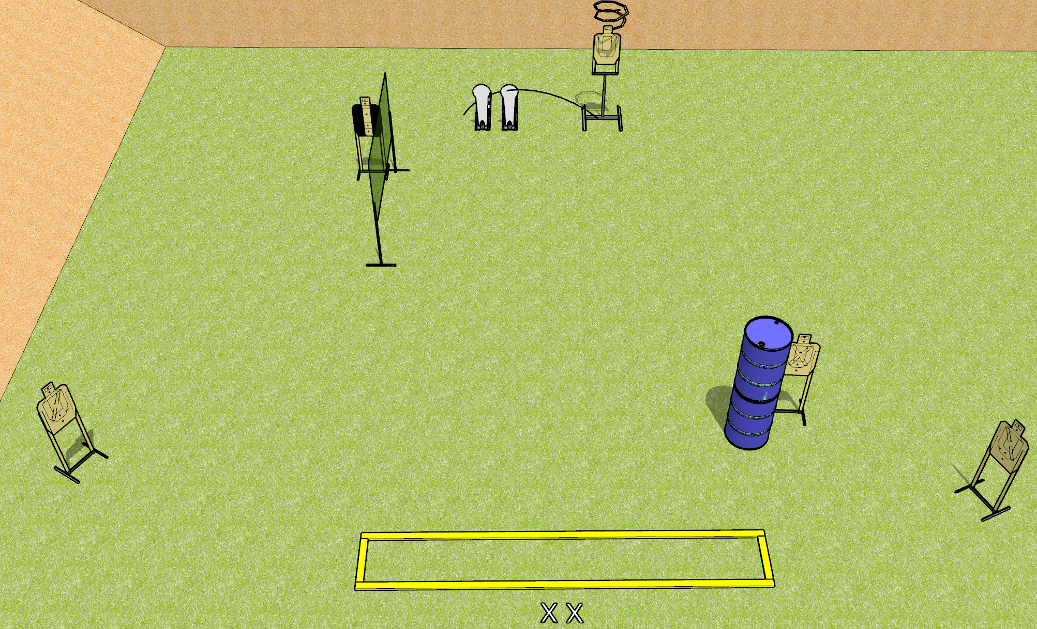
 | Dothan Gun Club – USPSA Match Measuring Yourself Again Course Designer : Drew Coleman
START POSITION : Standing with both feet on X’s, wrists below belt
GUN READY CONDITION : Pistol loaded and holstered. PCC loaded, held with both hands, shouldered, safety on, pointed at orange cone. |  | SCORING: Comstock, 12 rounds TARGETS: 5 paper, 2 Steel SCORED HITS: Best 2 on paper, steel until down START-STOP: Audible, last shot RULES: Drop turner is disppearing
STAGE PROCEDURE: Engage targets as they become available from within the fault lines.

Slide 2
Measuring Yourself Again
Written Stage Briefing
Measuring Yourself Again is a 12 round, 60 point, Comstock short course. There are five USPSA targets and two colt poppers. The best two hits on paper will score, and steel must fall to score. The start signal is audible.
Either colt popper will activate the drop turner. The drop turner is a disappearing target. Please check the activator and set it the same way every time.
Handgun start position is standing with both feet on X’s, wrists below belt. Handgun is loaded and holstered.
PCC start position is standing with both feet on X’s, muzzle pointed at orange cone. Loaded carbine is held with both hands, shouldered, safety on.
On start signal, engage targets as they become available from within the shooting area.

Slide 3
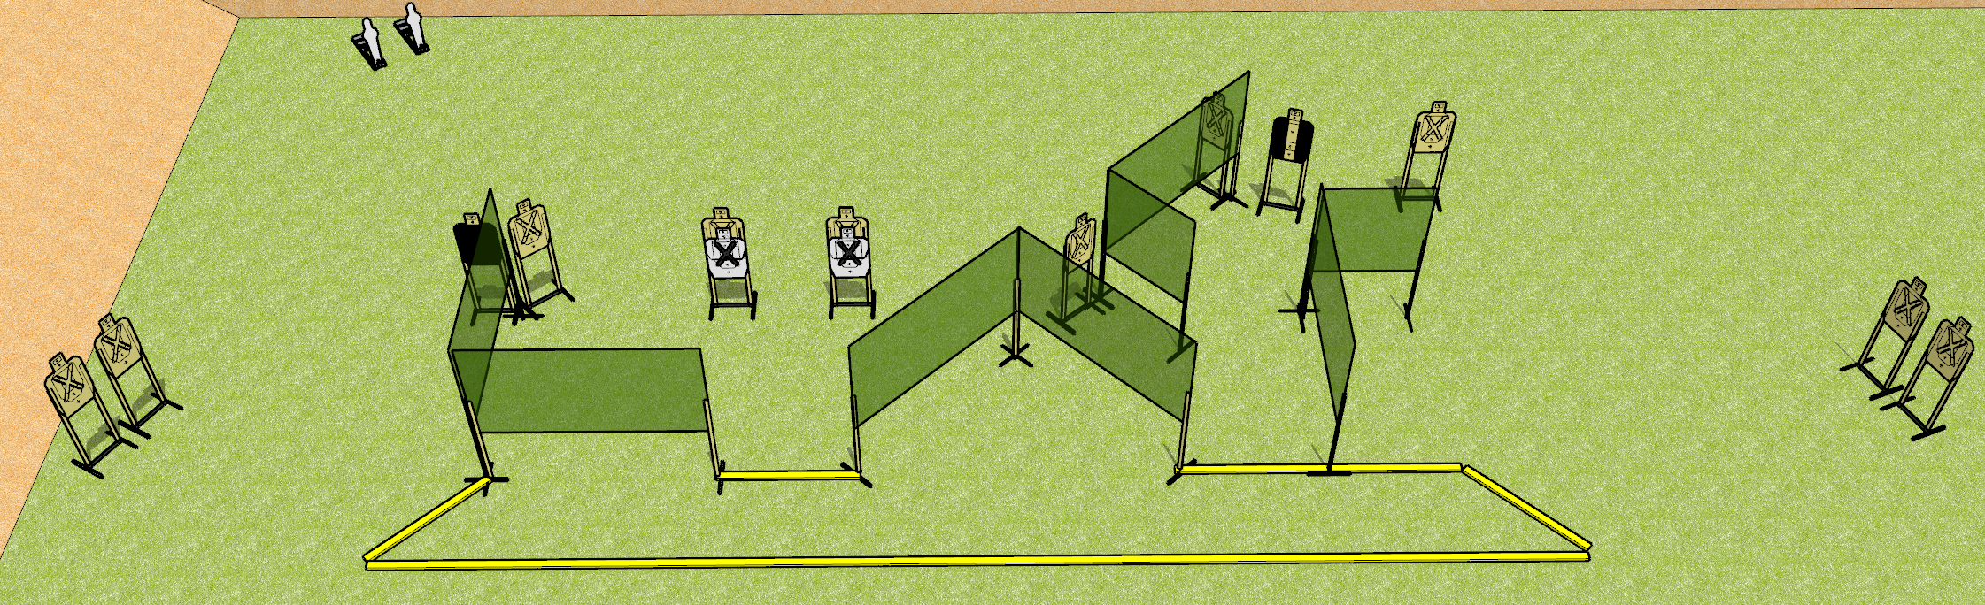
 | Dothan Gun Club – USPSA Match Tetris Course Designer : Drew Coleman
START POSITION : Standing with both feet outside the shooting area, wrists below belt
GUN READY CONDITION : Pistol loaded and holstered. PCC loaded, held with both hands, buttstock on belt, safety on. |  | SCORING: Comstock, 26 rounds TARGETS: 12 paper, 2 Steel SCORED HITS: Best 2 on paper, steel until down START-STOP: Audible, last shot RULES:
STAGE PROCEDURE: Engage targets as they become available from within the fault lines.

Slide 4
Tetris
Written Stage Briefing
Tetris is a 26 round, 130 point, Comstock field course. There are twelve USPSA targets and two mini poppers. The best two hits on paper will score, and steel must fall to score. The start signal is audible.
Handgun start position is standing with both feet outside the shooting area, wrists below belt. Handgun is loaded and holstered.
PCC start position is standing with both feet outside the shooting area. Loaded carbine is held with both hands, buttstock on belt, safety on.
On start signal, engage targets as they become available from within the shooting area.

Slide 5
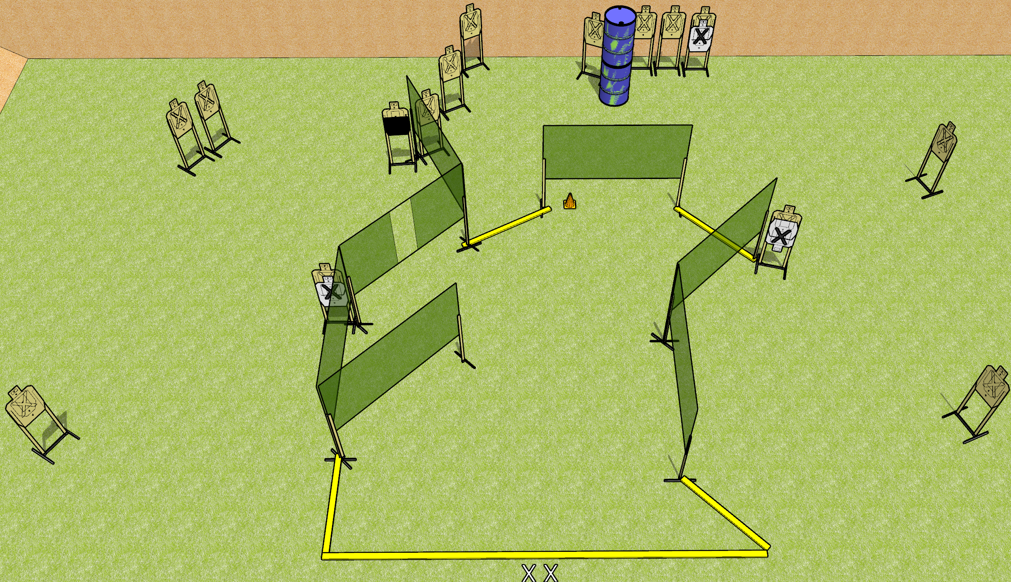
 | Dothan Gun Club – USPSA Match Burn it Down Course Designer : Drew Coleman
START POSITION : Standing with both feet on X’s, wrists below belt
GUN READY CONDITION : Pistol loaded and holstered. PCC loaded, held with both hands, shouldered, safety on, pointed at orange cone. |  | SCORING: Comstock, 30 rounds TARGETS: 15 paper, 0 Steel SCORED HITS: Best 2 on paper, steel until down START-STOP: Audible, last shot RULES:
STAGE PROCEDURE: Engage targets as they become available from within the fault lines.

Slide 6
Burn it Down
Written Stage Briefing
Burn it Down is a 30 round, 150 point, Comstock field course. There are fifteen USPSA targets. The best two hits on target will score. The start signal is audible.
Handgun start position is standing with both feet on X’s, wrists below belt. Handgun is loaded and holstered.
PCC start position is standing with both feet on X’s, muzzle pointed at orange cone. Loaded carbine is held with both hands, shouldered, safety on.
On start signal engage targets as they become available from within the shooting area.

Slide 7
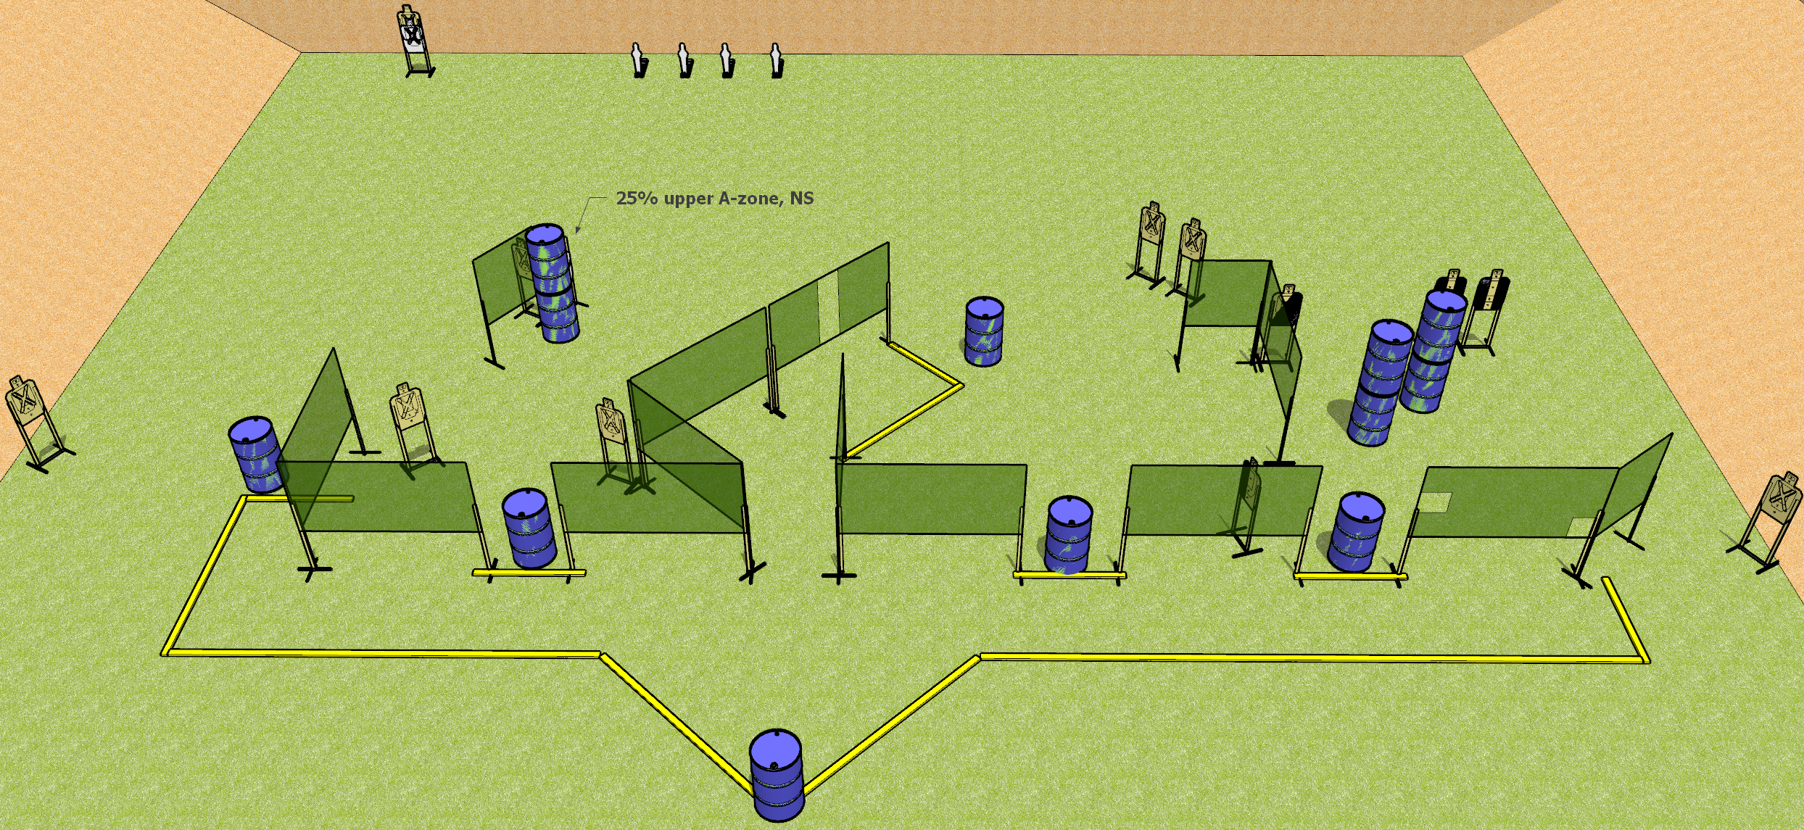
 | Dothan Gun Club – USPSA Match Here There Everywhere Course Designer : Drew Coleman
START POSITION : Standing with hands on knees *behind the rearmost barrel. *Uprange of and within the lateral confines of the specified object; e.g. "standing behind the table" means uprange of the table and inside the lines defined by the edges of the table (Appendix A3)
GUN READY CONDITION : Firearm loaded, safety on, placed unsupported on the barrel. All other magazines to be used in stage must be placed on ANY OTHER barrel |  | SCORING: Comstock, 30 rounds TARGETS: 14 paper, 4 Steel SCORED HITS: Best 2 on paper, steel until down START-STOP: Audible, last shot RULES:
STAGE PROCEDURE: Engage targets as they become available from within the fault lines.

Slide 8
Here There Everywhere
Written Stage Briefing
Here There Everywhere is a 30 round, 150 point, Comstock field course. There are fourteen USPSA targets and four mini poppers. The best two hits on paper will score, and steel must fall to score. The start signal is audible.
Start position is standing behind* the rearmost barrel, hands on knees. Firearm is loaded, safety on, laying unsupported on rearmost barrel. All other magazines to be used on the stage are placed on any other barrels.
On start signal, engage targets as they become available from within the shooting area.
*Behind means uprange of and within the lateral confines of the specified object; e.g. "standing behind the table" means uprange of the table and inside the lines defined by the edges of the table (Appendix A3).

Slide 9
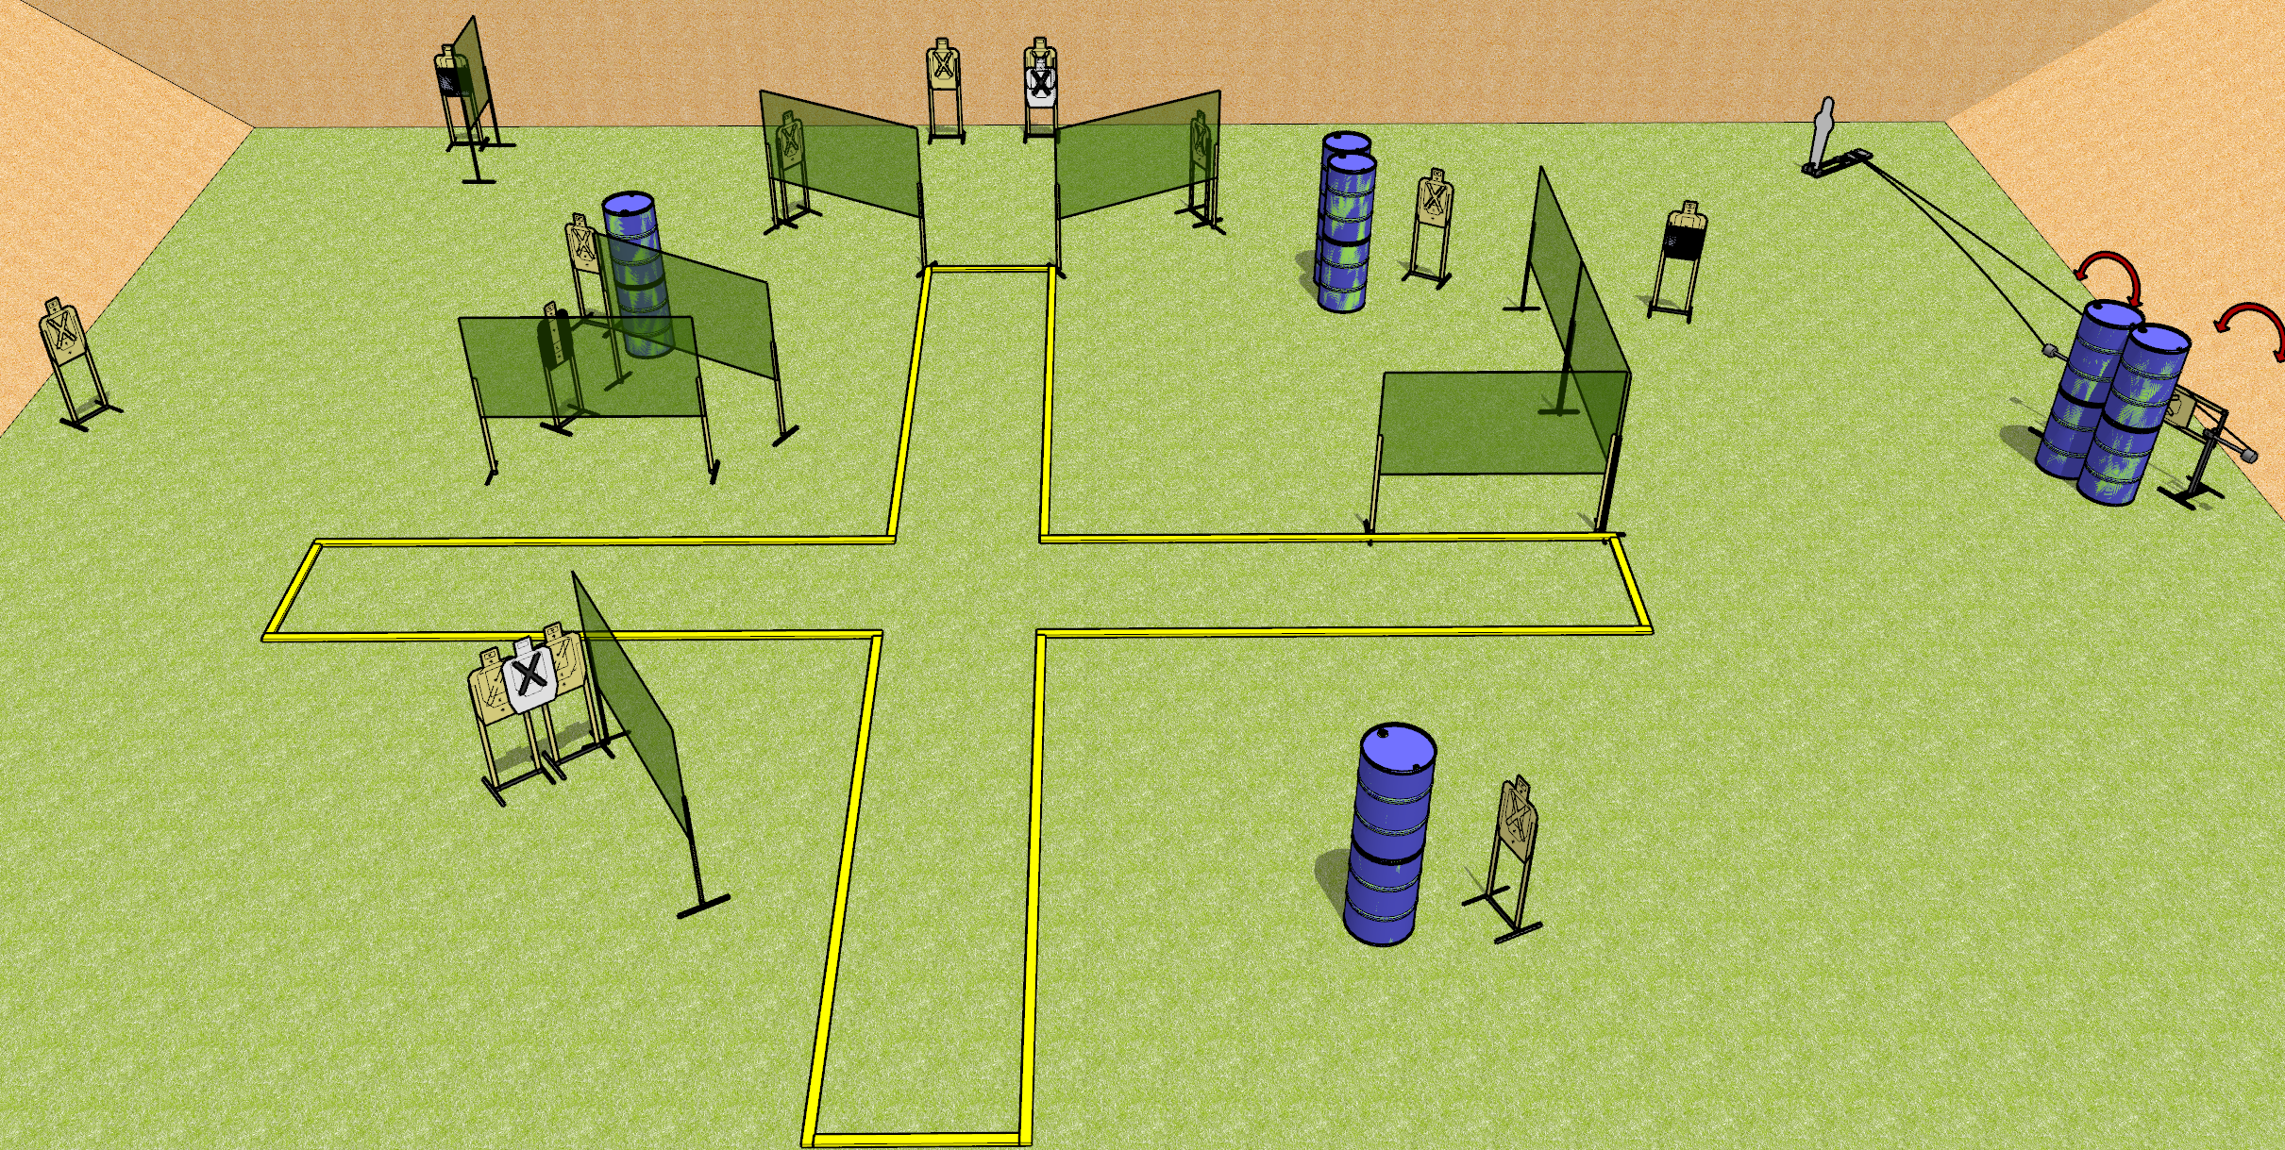
 | Dothan Gun Club – USPSA Match Plus Sized Course Designer : Drew Coleman
START POSITION : Standing anywhere inside the shooting area, wrists below belt
GUN READY CONDITION : Pistol loaded and holstered. PCC loaded, buttstock on belt, safety on. |  | SCORING: Comstock, 31 rounds TARGETS: 15 paper, 1 Steel SCORED HITS: Best 2 on paper, steel until down START-STOP: Audible, last shot RULES:
STAGE PROCEDURE: Engage targets as they become available from within the fault lines.

Slide 10
Plus Sized
Written Stage Briefing
Plus Sized is a 31 round, 155 point, Comstock field course. There are fifteen USPSA targets and one pepper popper. The best two hits on paper will score, and steel must fall to score. The start signal is audible.
Swinging targets one and two are activated by pepper popper one.
Handgun start position is standing anywhere inside the shooting area, wrists below belt. Handgun is loaded and holstered.
PCC start position is standing anywhere inside the shooting area. Loaded carbine is held with both hands, safety one, buttstock on belt.
On start signal, engage targets as they become available from within the shooting area.

Slide 11
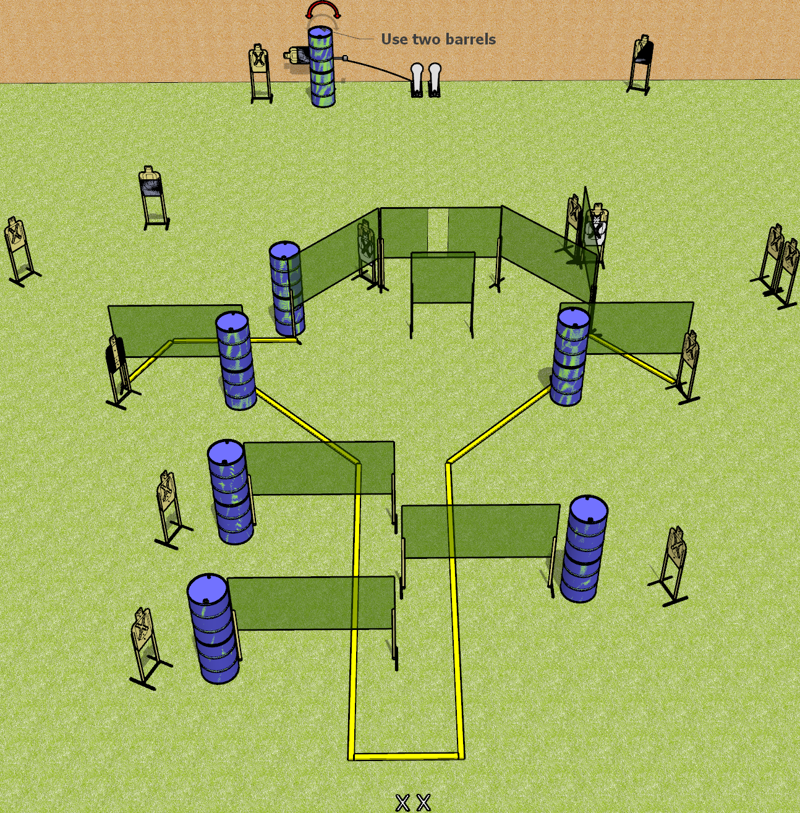
 | Dothan Gun Club – USPSA Match Just do it Course Designer : Drew Coleman
START POSITION : Standing with both feet on X’s, wrists below belt
GUN READY CONDITION : Pistol loaded and holstered. PCC loaded, held with both hands, shouldered, safety on, pointed at orange cone. |  | SCORING: Comstock, 32 rounds TARGETS: 15 paper, 2 Steel SCORED HITS: Best 2 on paper, steel until down START-STOP: Audible, last shot RULES:
STAGE PROCEDURE: Engage targets as they become available from within the fault lines.

Slide 12
Just do it
Written Stage Briefing
Just do it is a 32 round, 160 point, Comstock field course. There are fifteen USPSA targets and two colt poppers. The best two hits on paper will score, and steel must fall to score. The start signal is audible.
Left colt popper activates the swinger. Please check to see how the swinger is set before testing it, and set it the same way every time.
Handgun start position is standing with both feet on X’s, wrists below belt. Handgun is loaded and holstered.
PCC start position is standing with both feet on X’s, muzzle pointed at orange cone. Loaded carbine is held with both hands, shouldered, safety on.
On start signal, engage targets as they become available from within the shooting area.

Slide 13
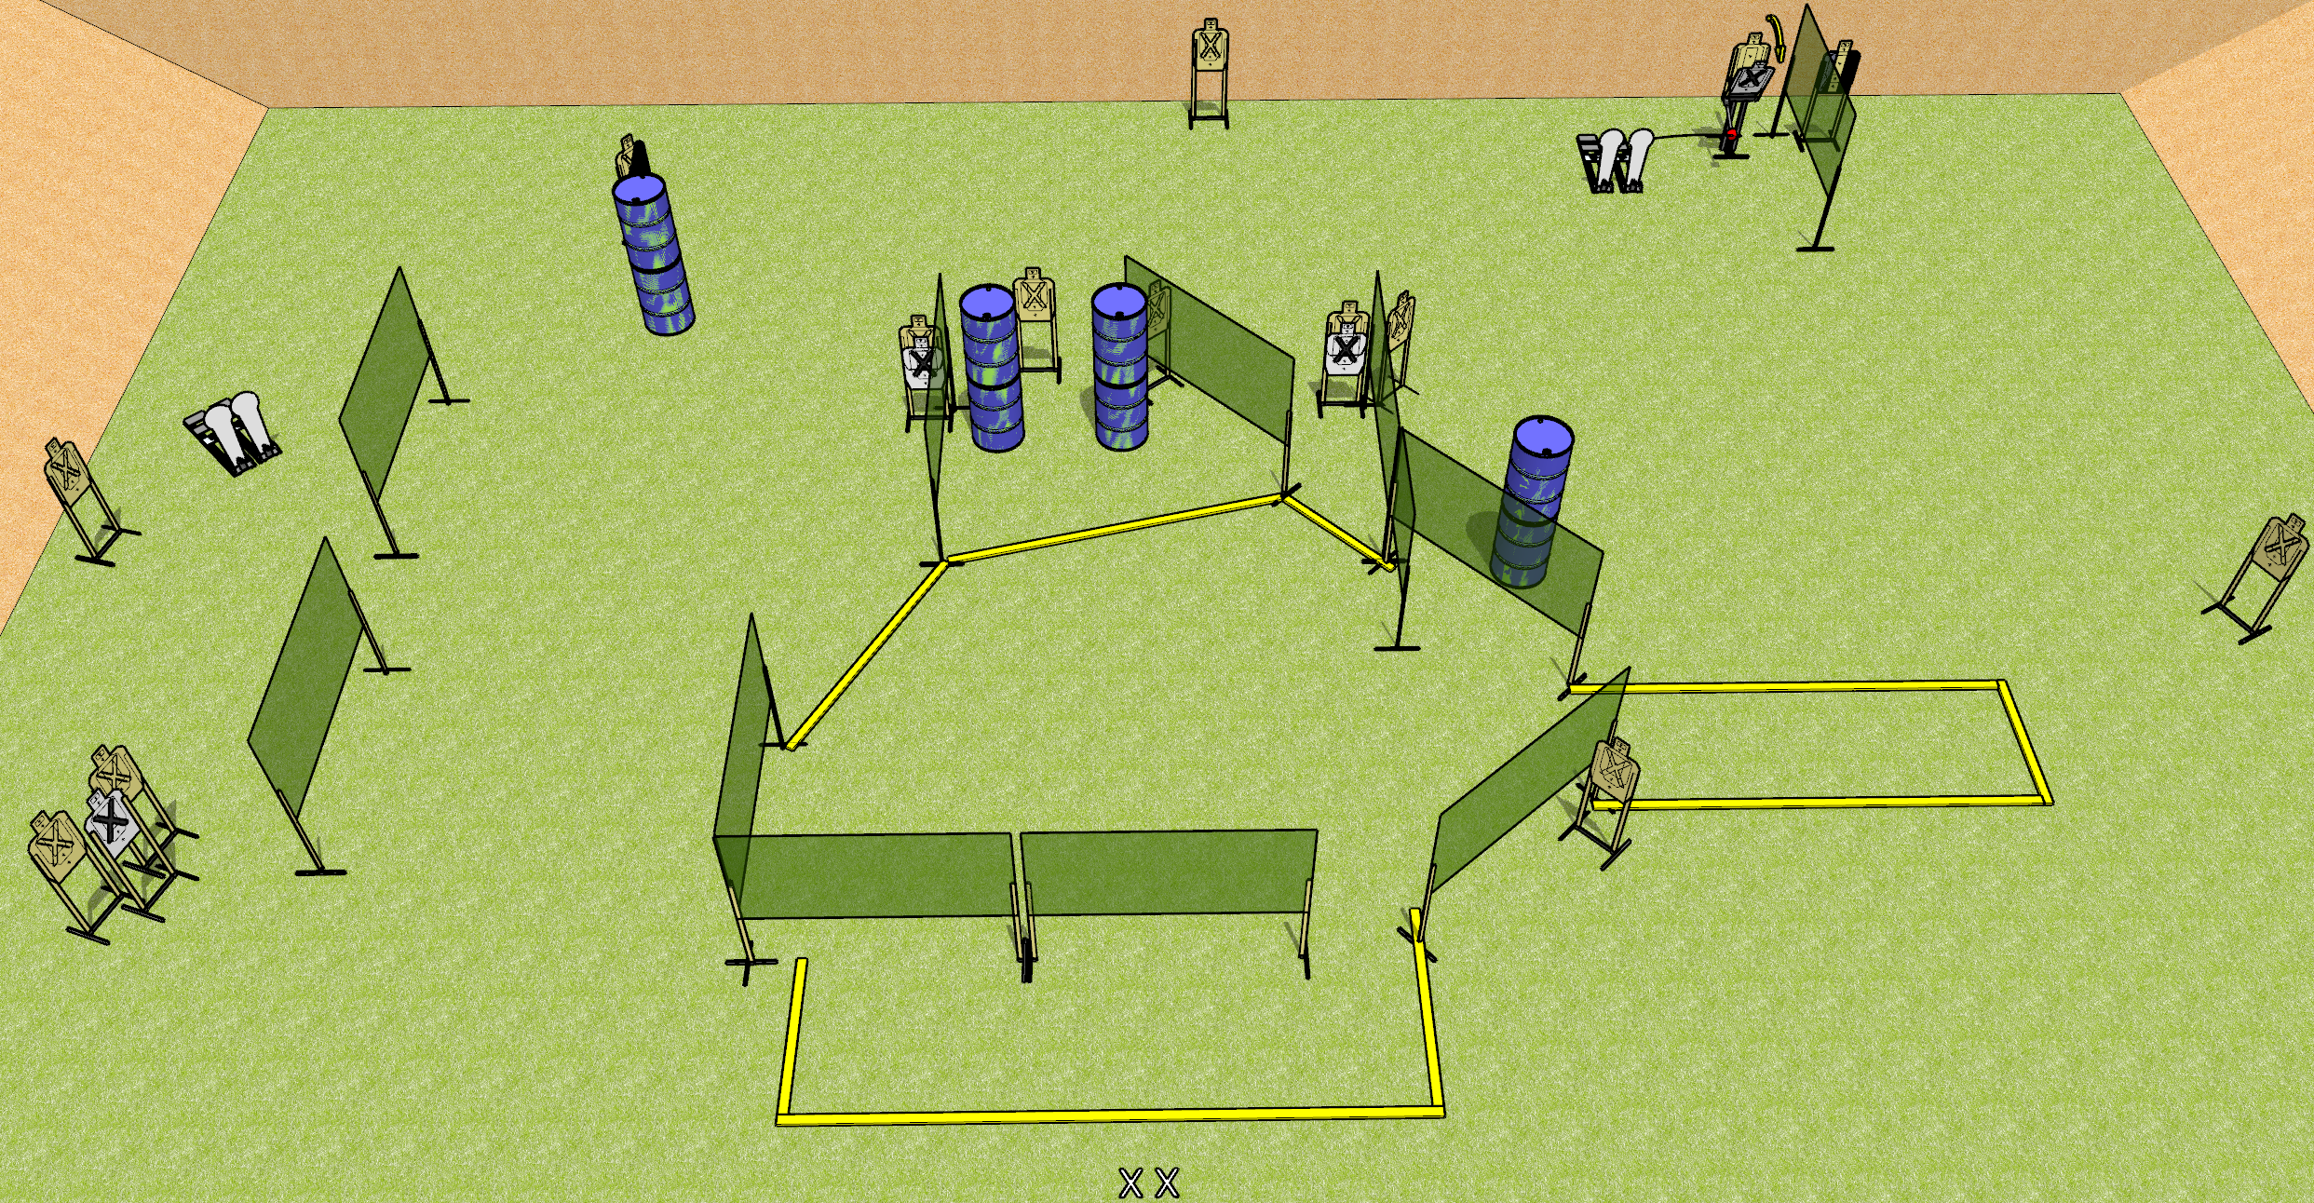
 | Dothan Gun Club – USPSA Match Quack! Course Designer : Drew Coleman
START POSITION : Standing with both feet on X’s, wrists below belt
GUN READY CONDITION : Pistol loaded and holstered. PCC loaded, held with both hands, shouldered, safety on, pointed at orange cone. |  | SCORING: Comstock, 32 rounds TARGETS: 14 paper, 4 Steel SCORED HITS: Best 2 on paper, steel until down START-STOP: Audible, last shot RULES:
STAGE PROCEDURE: Engage targets as they become available from within the fault lines.

Slide 14
Quack!
Written Stage Briefing
Quack! is a 32 round, 160 point, Comstock field course. There are fourteen USPSA targets and four Colt poppers. The best two hits on paper will score and steel must fall to score. The start signal is audible.
The right Colt popper will activate the Max trap. Please examine the activator prior to first shooter and set it up the same way each time.
Handgun start position is standing with both feet on X’s, wrists below belt. Pistol is loaded and holstered.
PCC start position is standing with both feet on X’s, muzzle pointed at orange cone. Loaded carbine is held with both hands, shouldered, safety on.
On start signal, engage targets as they become available from within the shooting area.

